Slide 1


Project Assignment IV: NIKE Business Report
Abdi Alamir
BTA 511 - FALL 2023
Professor Devdeep Aikath MBA/PhD
Business Technology and Analytics

Slide 2
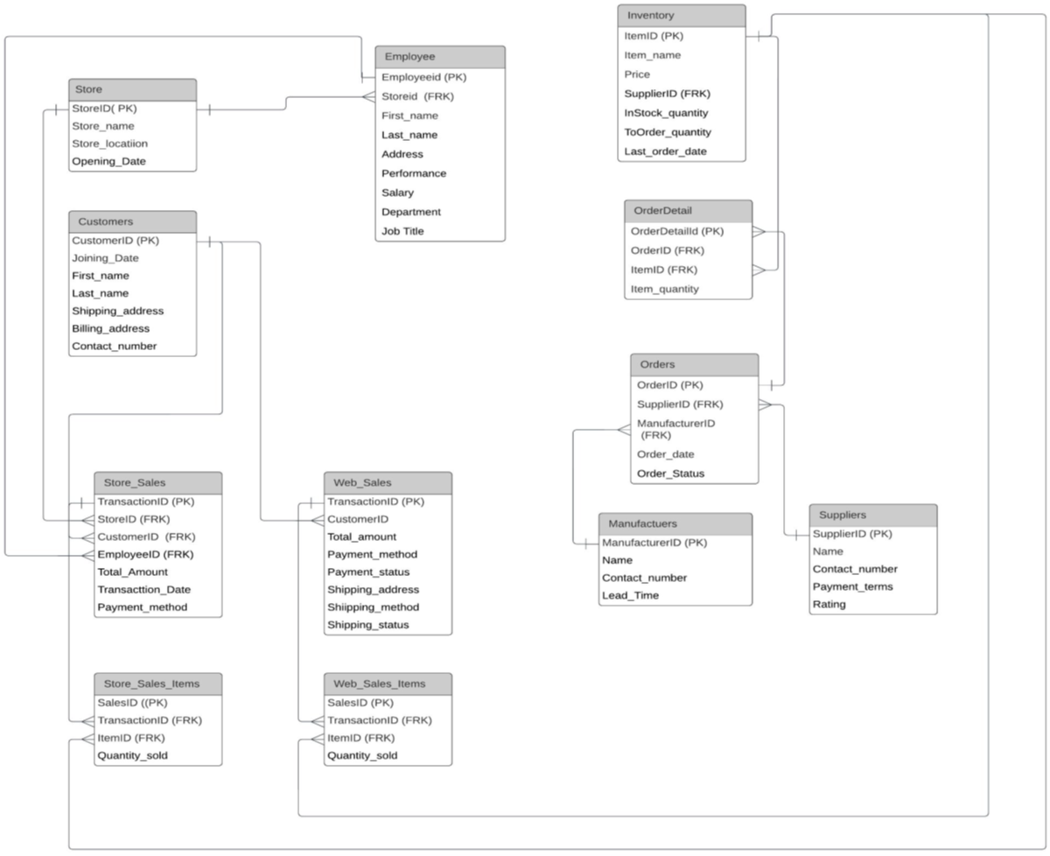
ER-Diagram
2

Slide 3
Key Stakeholders
Key Departments and
Key Stakeholders
Supply Chain & Operations
Design & Innovation
Accounting
Financial
Supply Chain Manager
Inventory management
Logistics and distribution management
Demand forecasting
Cost control
Product Innovation Manager
Market research
New products
Product lifecycle management
Competitive Analysis
Chief Financial Officer
Financial strategy
Risk management
Financial reporting
Compliance and regulation
Chief Financial Officer
Financial strategy
Risk management
Financial reporting
Compliance and regulation
3

Slide 4
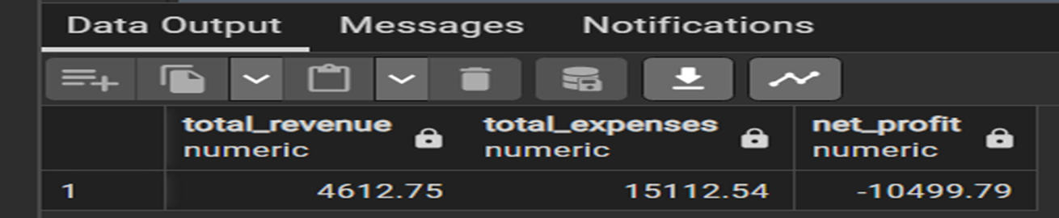
Financial
Report #1:
Financial Overview for Chief Financial Officer this query will retrieve total revenue, expenses, and net profit.
Total revenue: The sum of total sales from web transactions.
Expenses: The sum of expenses calculated based on ordered prices and their prices.
Net Profit: (total revenue – expenses).
SELECT
-- Total Revenue
COALESCE(SUM(ws.TotalAmount), 0) AS total_revenue,-- Using COALESCE to handle cases where there are no web sales. Default to 0 if there are no sales.
-- Total Expenses
COALESCE(SUM(od.ItemQuantity * i.Price), 0) AS total_expenses,-- Using COALESCE to handle cases where there are no orders or items.. Default to 0 if there are no sales.
-- Net Profit
COALESCE(SUM(ws.TotalAmount), 0) - COALESCE(SUM(od.ItemQuantity * i.Price), 0) AS net_profit --Using COALESCE to handle cases where either revenue or expenses are null.Default to 0 if there is no revenue or expenses.
-- Retrieving data from the relevant tables:
FROM
WebSales ws
LEFT JOIN WebSalesItems wsi ON ws.TransactionID = wsi.TransactionID -- Joining WebSalesItems to get details of items sold in web transactions.
LEFT JOIN OrderDetail od ON ws.TransactionID = od.OrderID -- Joining OrderDetail to link web transactions with ordered items.
LEFT JOIN Inventory i ON wsi.ItemID = i.ItemID; -- Joining Inventory to fetch item prices for expense calculation.
5

Slide 5
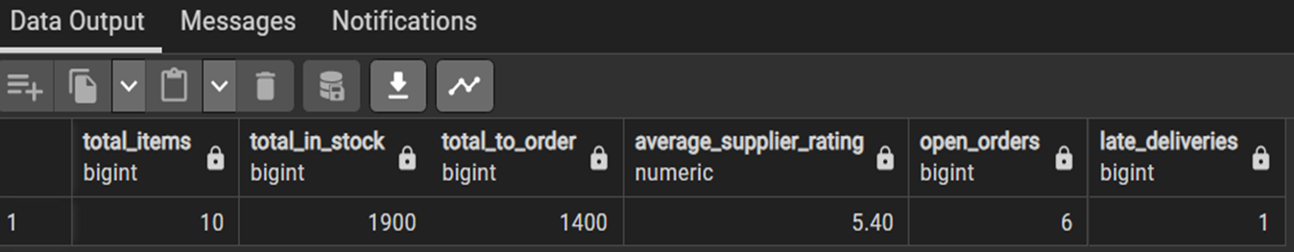
Supply Chain
Management
Report #2:
Is for the Supply Chain Manager for selecting key supply chain metrics and getting an Inventory Summary.
SELECT
-- Inventory Summary
COUNT(Inventory.ItemID) AS total_items,-- Counting the total number of items in the inventory
SUM(InStockQuantity) AS total_in_stock,-- Summing up the instock quantities
SUM(ToOrderQuantity) AS total_to_order,-- Summing up the quantities to order
-- Supplier Performance
-- Calculating the average rating of suppliers rounded to two decimal places
round(AVG(Rating),2) AS average_supplier_rating, --utilize the AVG function to assess overall supplier performance; DISINCT used to count only unique orders
-- Open Orders
COUNT(DISTINCT orders.OrderID) AS open_orders, -- counting the number of distinct open orders; helps monitoring the current workload
-- Late Deliveries
COUNT(DISTINCT CASE WHEN OrderStatus = 'Delivered' AND CURRENT_DATE > OrderDate + LeadTime THEN orders.OrderID END) AS late_deliveries --Counting the number of distinct late deliveries
-- identified orders marked as 'Delivered' where the current date exceeds the expected delivery date
-- Retrieving data from the relevant tables:
FROM
Inventory
LEFT JOIN orderdetail ON Inventory.itemID = orderdetail.itemID --Joining OrderDetail to link inventory items with order details
LEFT JOIN Orders ON orderdetail.orderID = Orders.orderID --joining orders to get order status and expected delivery dates
LEFT JOIN suppliers ON orders.supplierID = suppliers.supplierID --joining suppliers to assess supplier performance based on ratings
LEFT JOIN Manufacturers ON orders.orderID = Manufacturers.ManufacturerID;
7

Slide 6
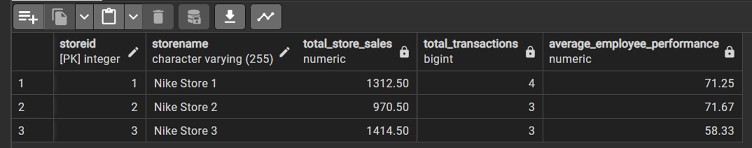
Accounting
Report #3:
Is for the Chief Financial Officer for selecting Key store performance metrics.
Store Sales Summary: Grouping by StoreID and StoreName to provide a summary for each store and summing up the total store sales and counting the number of distinct transactions gives an overview of the sales performance for each store.
SELECT
s.StoreID,
s.StoreName,
SUM(ss.TotalAmount) AS total_store_sales, ----Summing up the total store sales
COUNT(DISTINCT ss.TransactionID) AS total_transactions, -- counting the number of distinct transactions
--Employee Performance
round(AVG(e.Performance),2) AS average_employee_performance --Calculate the average performance rating of employees for each store
--Utilizes the AVG function to assess the overall performance of store employees
-- Retrieving data from the relevant tables:
FROM
StoreSales ss
JOIN Store s ON ss.StoreID = s.StoreID -- joining store to link store sales with with store details
JOIN Employee e ON ss.EmployeeID = e.EmployeeID -- joining employee to assess the average performance of store employees
GROUP BY
s.StoreID, s.StoreName; --grouping by storeID and storeName for a summary at the store level
6

Slide 7

Design & Innovation
Report #4:
Is for the Product Innovation Manager for selecting key metrics related to product diversity and customer preferences. Selecting key metrics related to product diversity and customer preferences:
SELECT
i.ItemID,
i.ItemName,
i.Price,
i.InStockQuantity,
i.ToOrderQuantity,
COUNT(wsi.TransactionID) AS total_sales, -- counting the total sales for each product
round(AVG(wsi.QuantitySold),2) AS avg_quantity_sold, --calculating the average quantity sold and round it up to the second decimal place
MAX(wsi.QuantitySold) AS max_quantity_sold,--calculating the maximul quantity sold for each product
MIN(wsi.QuantitySold) AS min_quantity_sold,--calculating the minimal quantity sold for each product
MAX(ws.TotalAmount) AS max_transaction_amount,--capturing the heighst transaction amount
MIN(ws.TotalAmount) AS min_transaction_amount,--capturing the lowest transaction amount
COUNT(DISTINCT ws.CustomerID) AS unique_customers --counting the number of unique customers who purchased each product.
-- Retrieving data from the relevant tables:
FROM
Inventory i
LEFT JOIN WebSalesItems wsi ON i.ItemID = wsi.ItemID --Joining WebSalesItems to link products with web transactions and their sales details
LEFT JOIN WebSales ws ON wsi.TransactionID = ws.TransactionID --joining websales to get additional transaction details
GROUP BY --(grouping by product attributes for a comprehensive summary at the product level)
i.ItemID, i.ItemName, i.Price, i.InStockQuantity, i.ToOrderQuantity
ORDER BY
total_sales DESC -- Sorting the results by total sales in descending order
LIMIT 10; --limiting to the top 10 products.
8

